Slide 1
Exploring CO2 Emissions from Automobiles
Andrew Mashhadi | STAT411

Slide 2

Introduction
Carbon dioxide (CO2) emissions is often recognized as one of the main drivers in global climate change.
Countries are urgently trying to reduce their annual emissions to prevent any further impacts of climate change.
Automobiles significantly contribute to the total annual CO2 emissions each year.

Slide 3
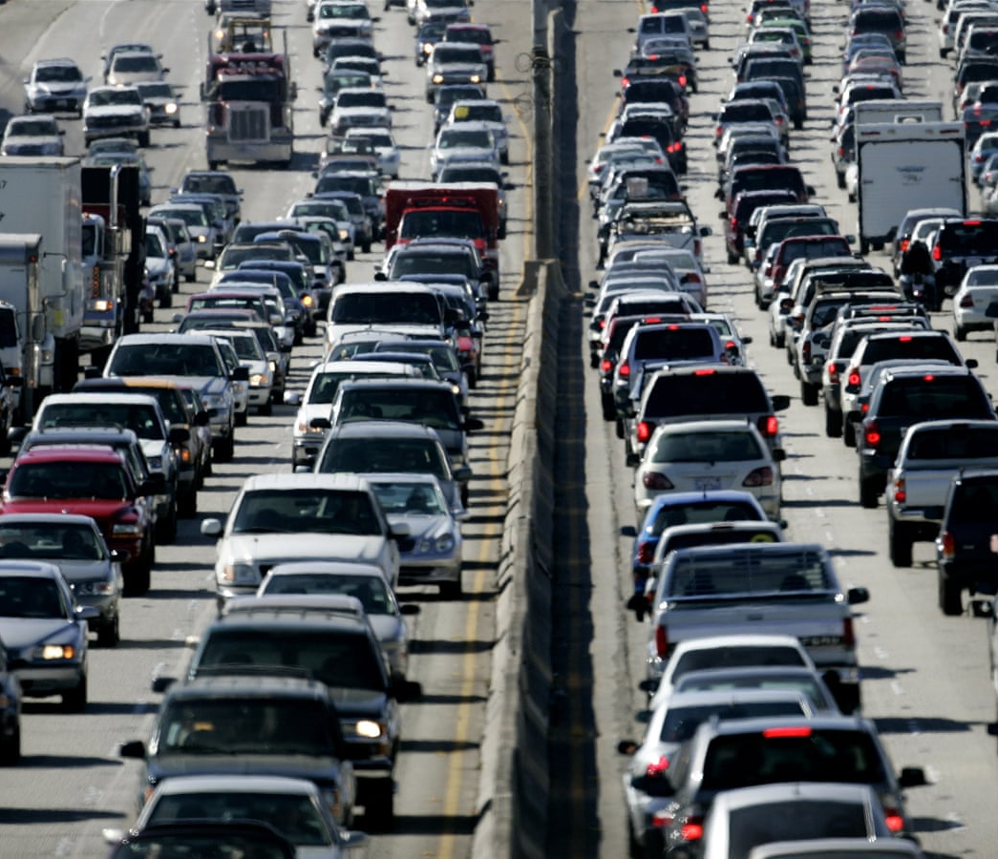
Introduction
In this project:
I used PCA and Factor Analysis with multiple linear regression to explore emissions data to bring out strong patterns between various vehicle attributes and CO2 emissions.
I attempted to characterize the key factors affecting emission levels.
Examined the overall fit of each model, assessed the corresponding predictive performance, and investigated the relationship between the main factors and the expected CO2 emissions.

Slide 4
Data
Canadian Government’s official open-access website. [2]
Collected over 7 years.
Over 7000 observations and 10 original variables.
Each observation is associated with an independent automobile and includes a variety of vehicle attributes with an associated CO2 emission (measured in grams per kilometer).
Original vehicle attributes consisted of: Make, Model, Vehicle Class, Engine Size, Cylinders, Transmission, Fuel Type, City Fuel Consumption, Highway Fuel Consumption.

Slide 5
Data Cleaning and Feature Engineering
Although we have 9 explanatory variables and 1 response variable (CO2 Emissions), many of the categorical features contain a plethora of categories.
This vastly increases the dimension of the feature space when dummy coding is applied to the variables.
Most of these original categorical variables were split up, or recategorized, in an attempt limit the number of categories from a single feature, and to combine any categories based on general commonalities.

Slide 6
Data Cleaning and Feature Engineering
Make
Economic Class
Toyota
Ford
Honda
BMW
.
.
.
Porsche
Economy
Premium
Luxury
The original variable “Make” was replaced with “Economic Class” since it had too many categories.
Note that the new economic class variable also has a natural order to it.
+ 40 Categories
3 Categories

Slide 7

Data Cleaning and Feature Engineering
Model
Corolla
Prius
Merc. C300
BMW 330i
.
.
.
Subaru STI
The original variable “Model” had over 2000 different categories.
I removed this feature from consideration since there would simply be too many categories compared to the number of observations.
+ 2000 Categories

Slide 8
Data Cleaning and Feature Engineering
Drive
Drive
4WD
2WD
AWD
.
.
.
XDRIVE
Two-Wheel Drive
All-Wheel Drive
The original variable “Drive” had over 5 different categories, and many of which meant the same thing.
I re-categorized this variable to have 2 categories.
+ 5 Categories
2 Categories

Slide 9
Data Cleaning and Feature Engineering
Vehicle Class
Vehicle Class
Sedan
Van
Truck
.
.
.
SUV
Compact
Mid-Size
Full-Size
Large-Vehicle
The original variable “Vehicle Class” had over 15 different categories, and many of them were closely related.
I re-categorized this variable to have 4 categories.
+ 15 Categories
4 Categories

Slide 10
Data Cleaning and Feature Engineering
Fuel Type
Fuel Type
Regular Gas
Premium Gas
Ethanol
Diesel
Natural Gas
Regular Gas
Not-Regular Gas
For simplicity, I re-categorized the “Fuel Type” variable as well.
Each observation was grouped within a “Regular Gasoline” category or a “Not-Regular Gasoline” category.
5 Categories
2 Categories

Slide 11
Data Cleaning and Feature Engineering
Transmission Type
Transmission
Automatic
Manual
A4
AM4
AV
M6
.
.
.
A8
2 Categories
For “transmission”, each observation was given a specific acronym that effectively described the type of transmission and its number of gears.
Therefore, I split this variable into two new variables: “Transmission Type” and “Number of Gears”
Number of Gears
Numerical Variable

Slide 12
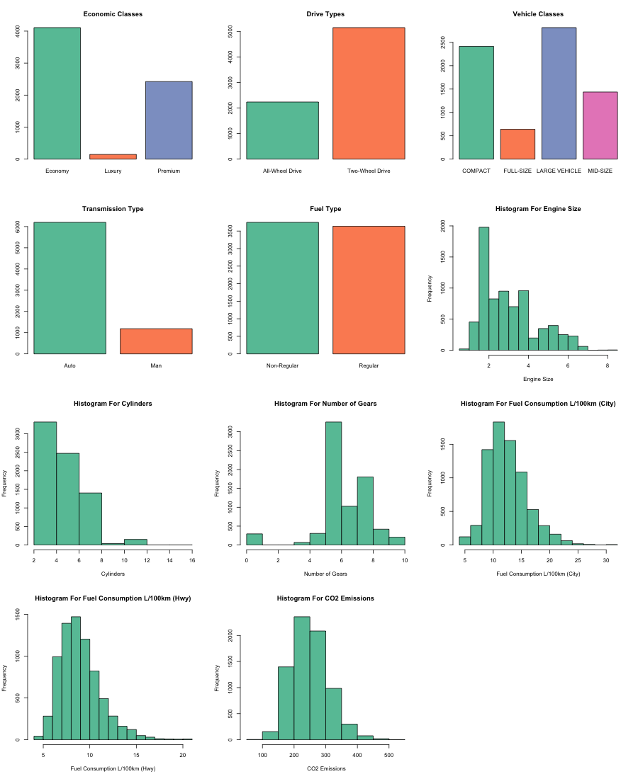
Exploratory Data Analysis
I explored the one-way distributions for the numerical variables and the one-way frequency tables for the categorical variables.
Notice that all the continuous variables except for Engine Size and Cylinders have approximately normal distributions, while the variables Engine Size and Cylinders seem to have right (positive) skewed distributions.
All the cleaned categorical variables demonstrate large sample sizes (n > 100) in each category.
CO2 Emissions clearly demonstrated normality with an estimated mean of about 250 g/km and an estimated standard deviation of about 59 g/km.

Slide 13
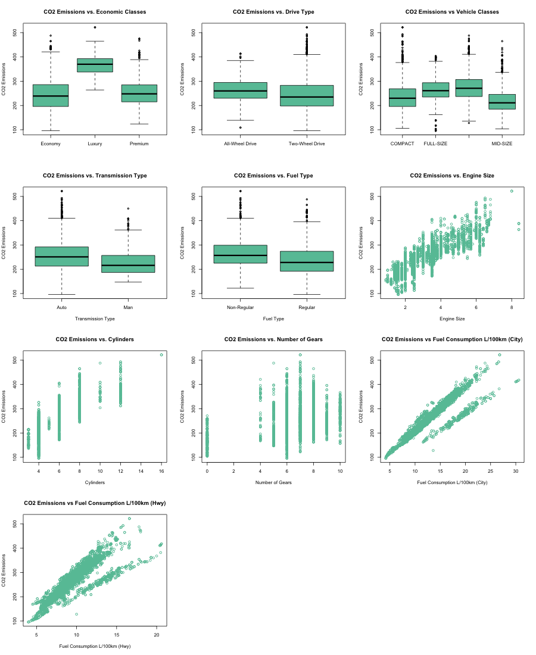
Exploratory Data Analysis
I explored the two-way relationships between each vehicle feature and the CO2 Emissions
Box-plots were used for the categorical variables to illustrate potential differences in the distribution of CO2 emissions when conditioned on each category
Scatter-plots of the CO2 emissions against the explanatory variable were used for the numerical features.
All categorical variables indicated significantly different means (with similar distributions) for each category of the associated vehicle feature.
All numerical features except for “Number of Gears” demonstrated a clear, positive, linear relationship with the CO2 emissions.

Slide 14
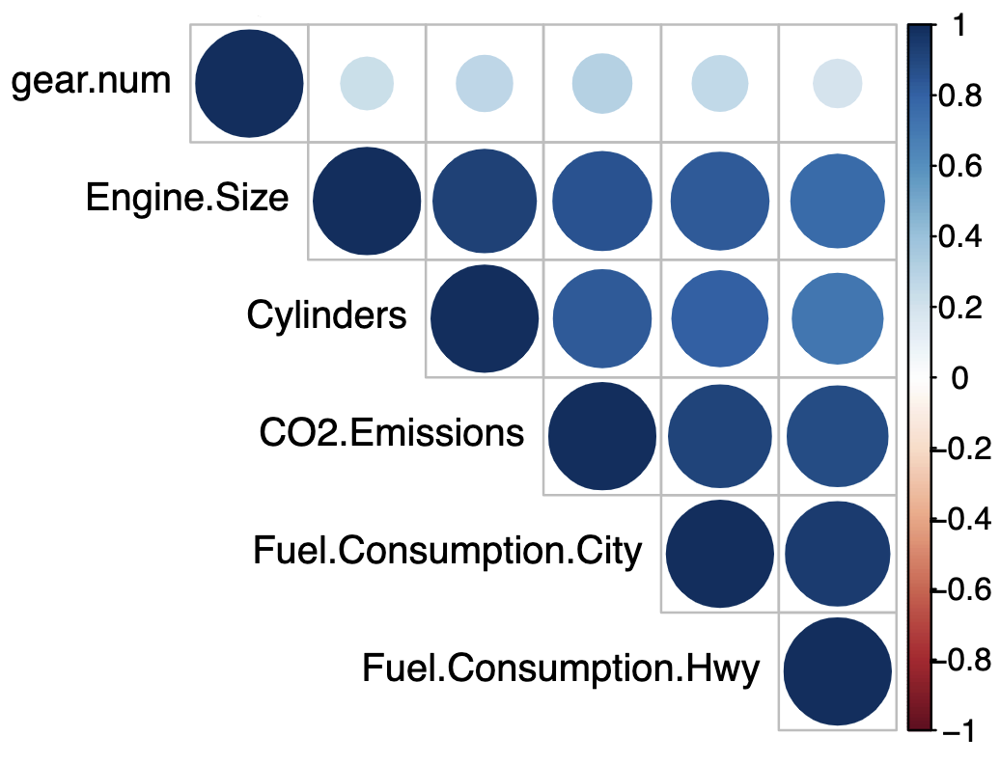
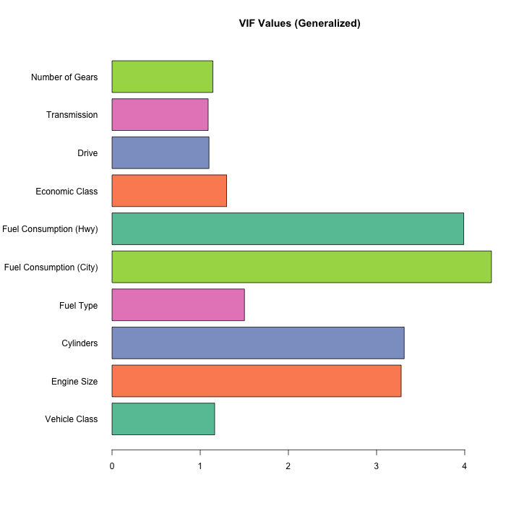
Exploratory Data Analysis
I investigated the relationships between the cleaned variables in the dataset.
All VIF values are approximately less than or equal to 5, so I had no reason to believe any negative effects from multicollinearity would impact the analyses or models.
The correlation plot indicated that most of the numeric variables have a relatively large correlation with CO2 Emissions and with each other.
PCA and Factor Analysis should help alleviate some of the negative effects that may arise from collinearity when applied before modeling.

Slide 15
Methodology
Constructed a training and testing set with an 80/20 split of the original data.
Since many of the variables used are not in the same units, I scaled both sets using the estimated means and standard deviations from only the training set.
Applied PCA to the automobile attributes in the training data to reduce the dimensions of the data while minimizing information loss.
Investigated the loadings of the first few components.
Based on the location of the “elbow” in the corresponding scree plot and the cumulative variance explained by the principal components, I choose an optimal number of components.
Linearly transformed the training data into principal components that were used to fit a multiple linear regression model.
Linear model assumptions were checked, residual diagnostics were examined, and the significance of each coefficient was tested.

Slide 16
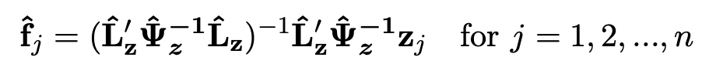
Methodology
I also applied factor analysis to the training data, using the Maximum Likelihood method:
A varimax rotation was used to help “spread out” the squares of the loadings on each factor in hope of finding groups of large and negligible coefficients in any column of the rotated loadings.
The loadings of the first few factors were investigated and interpreted in order to characterize the key factors found among the original automobile features.
The location of the “elbow” in the corresponding scree plot and the cumulative variance explained by the factors was used to choose an optimal number of factors.
With the loadings from the first optimal number of factors, I then generated factor scores using the weighted-least-squares method shown in class:
These factor scores were then used as input for another multiple linear regression model.
Again, the linear model assumptions were checked, residual diagnostics were examined, and the significance of each coefficient was tested.
Both linear regression models were evaluated and compared on the test dataset using R-Squared and RMSE.

Slide 17
A Note On Correlation Structure
Traditionally, one-hot encoding is applied to categorical variables so that the variables may be used appropriately in our analyses and models.
One-hot encoding effectively creates a new dichotomous variable (1 or 0) for each category in the associated variable.
Normally, this approach is perfectly fine before applying a machine learning model such as linear regression. However, when applying PCA or Factor Analysis, using an estimated correlation matrix, R, from Pearson’s correlations is not technically appropriate because Pearson’s correlations assume that the variables are continuous and follow a multivariate normal distribution.
Pearson’s correlation technically should not be used on dichotomous or ordinal variables (although it is often performed) [1].

Slide 18
A Note On Correlation Structure
Therefore, I also tried using a more appropriate estimate for the correlation of the categorical variables.
I estimated the correlation matrix, R, using a mix of different correlation methods.
Numerical variables still used Pearson’s correlation coefficient.
Dichotomous categorical variables used tetrachoric correlation [3].
Multi-class, ordinal, categorical variables used polychoric correlation [3] with associated natural orderings.
Polyserial or biserial correlations were used to estimate the elements of R that represented the correlation between a continuous variable and an ordinal, or dichotomous, variable.
The analyses and modeling results from using standard one-hot encoding with Pearson’s correlations were presented along with the results from using the mixed correlations.

Slide 19
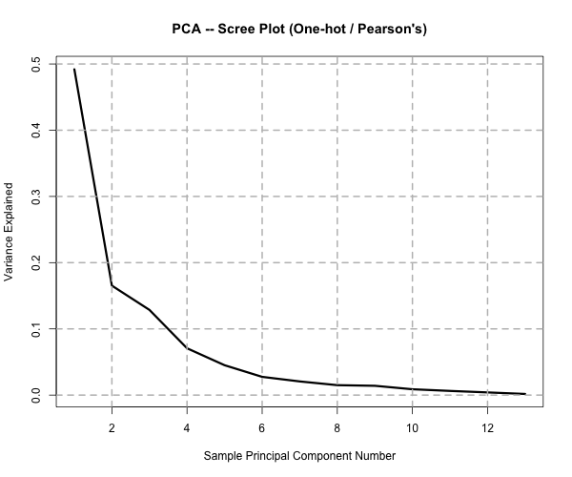
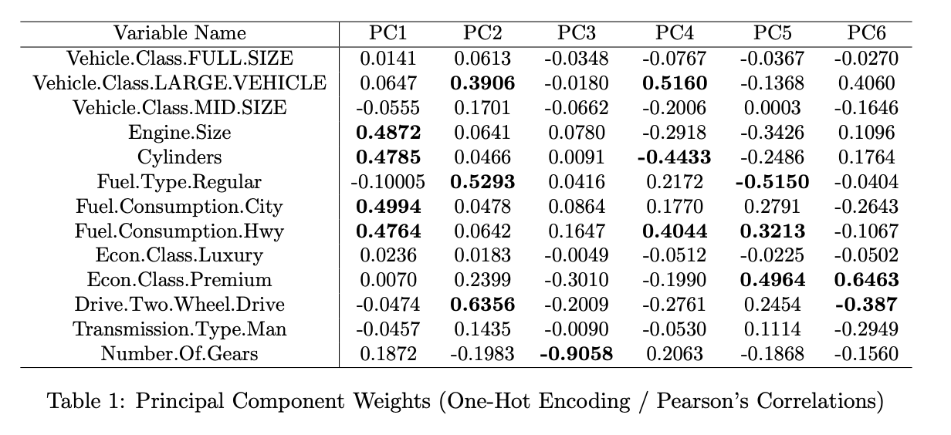
Results & Interpretation
Principal Component Analysis (One-hot / Pearson’s)
After one-hot encoding the categorical variables, there were a total of 13 predictor variables in the training data.
Using only Pearson’s correlations, I calculated the 13 sample principal components from the training data.
From the scree plot and the summary of variance explained, I decided to keep only the first 6 components (explained over 95% of the sample variance in training data).
Notice that the larger weights of PC1 (≈ 0.5) are exclusively associated with variables like Engine Size, Cylinders, and Fuel Consumption levels, so PC1 may be interpreted as an average measure of engine power, or engine output.
The relatively larger weights associated with Large Vehicle, Regular Fuel Type, and Two-Wheel Drive in PC2 indicates that PC2 may represent an aggregate measure for regular, non-premium, large passenger vehicles. For instance, this could represent a typical middle-class family-oriented car, since they are typically larger, two-wheel drive vehicles that do not require special fuel.
While PC3 appears to be heavily dominated by the Number of Gears variable, the 3 remaining principal components may also be interpreted in a fashion as PC1 and PC2.

Slide 20

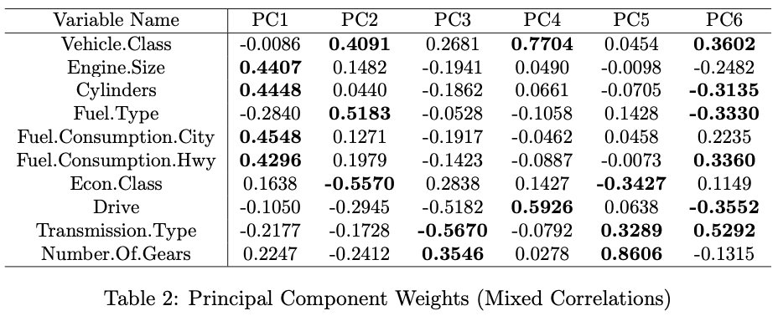
Results & Interpretation
Principal Component Analysis (Mixed Correlations)
As mentioned, I reperformed PCA using a combination of different correlation estimates depending on the variable type.
The mixed-type correlation estimates were used to calculate the sample principal components.
Since one-hot encoding was not performed, there were only 10 predictor variables in the training data before applying PCA.
From the scree plot and the summary of variance explained, I decided to keep only the first 6 components (explained over 95% of the sample variance in training data).
Again, the heavier weights on Engine Size, Cylinders, and Fuel Consumption levels indicate that PC1 may be interpreted as an average measure of engine power, or engine output.
PC2 has a different interpretation now: The Vehicle Class and Fuel Type variables have larger positive weights while the Economic Class variable has a large negative weight, implying that PC2 may represent the difference between a vehicle’s overall size and its general status.
Note that in this case we can see that none of the components seem to be dominated by any single predictor.

Slide 21
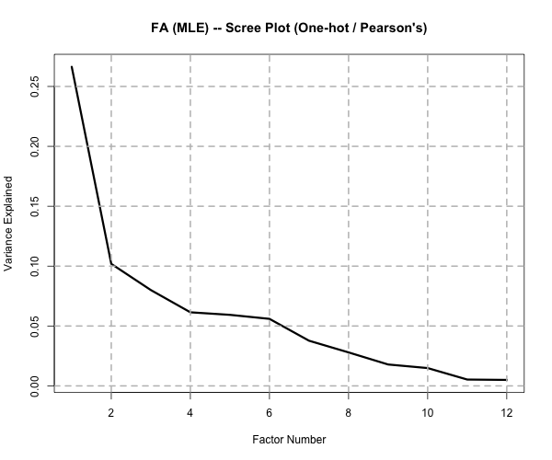
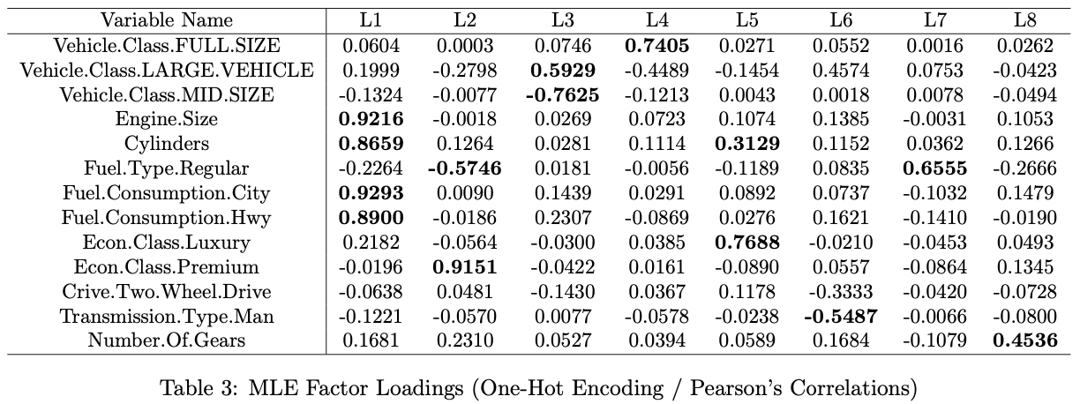
Results & Interpretation
Factor Analysis (One-hot / Pearson’s)
Used only the Pearson’s correlations from the One-Hot encoded training data to compute the 13 factor loadings
After examination of the scree plot and the variance explained by each factor, I decided to keep only the first 8 factors (explained only about 69% of the sample variance in training data).
Interestingly, Engine Size, Cylinders, and Fuel Consumption levels all load highly on the first factor again, so this first factor may represent an abstract measure of engine strength, power, or output as well.
Since premium vehicles generally require premium gasoline, this second factor seems to represent the contrast between standard vehicles and premium vehicles, with a heavy emphasis on the vehicle’s fuel type.
Many of the remaining factors appear to be dominated by a single predictor variable as highlighted in Table 3.

Slide 22
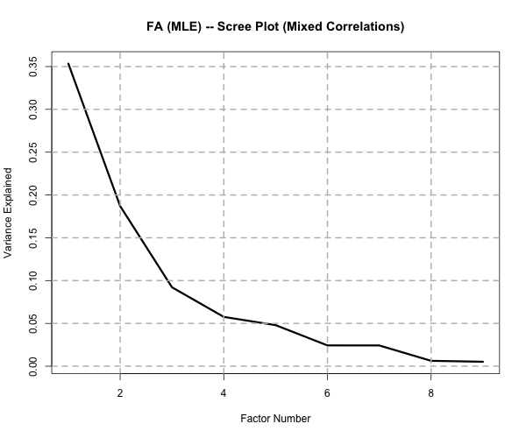
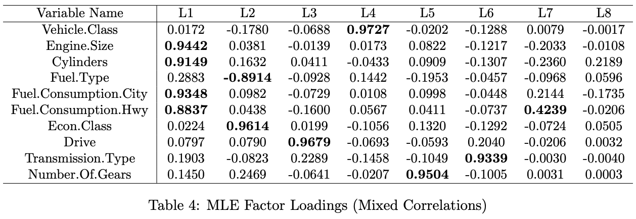
Results & Interpretation
Factor Analysis (Mixed Correlations)
Again, I reperformed factor analysis using a combination of different correlation estimates depending on the variable type.
The mixed-type correlation estimates were used to calculate the factor loadings.
Since one-hot encoding was not performed, there were only 10 predictor variables in the training data before applying factor analysis.
After examination of the scree plot and the variance explained by each factor, I decided to keep only the first 8 factors (now explaining about 79.3% of the sample variance in training data).
Again, we can see that Engine Size, Cylinders, and Fuel Consumption levels all load highly on the first factor. Therefore, the first factor may represent an abstract measure of engine strength, power, or output.
Similarly, the second factor seems to represent the contrast between standard vehicles and premium vehicles, where fuel type is used to distinguish the two classes.
From the larger loading values of Drive and Transmission, it appears that the third factor may represent an abstract measure of how “sporty” the vehicle is, since most pure sports cars are manual and two-wheel drive.
The remaining factors that are not heavily dominated by a single predictor may be interpreted in a similar fashion.

Slide 23
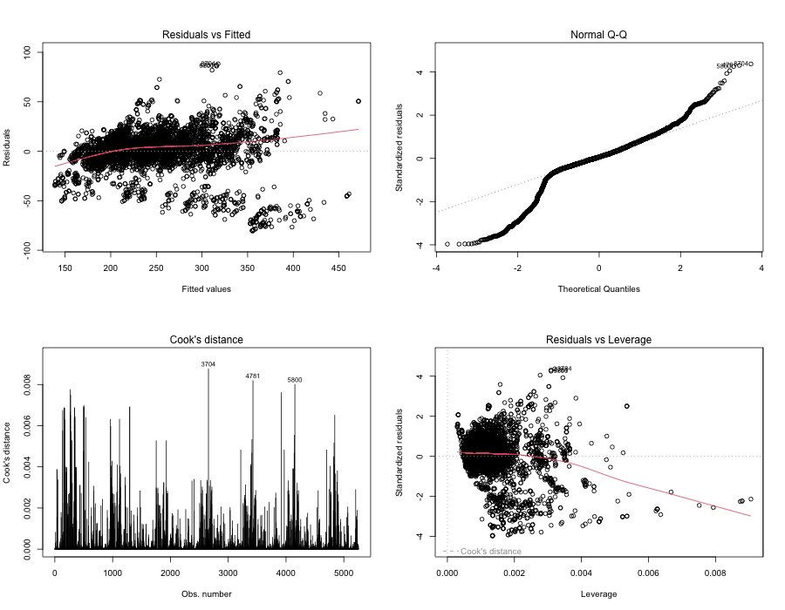
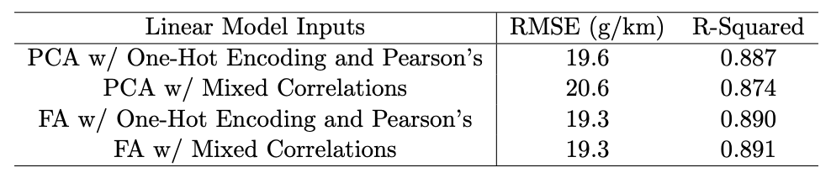
Results & Interpretation
Linear Regression Modeling
The two sets of principal components and the two sets of factors scores were used as inputs for four different linear regression models.
In all models, most (if not all) of the components or factors were found to be significant, and each set of components or factors demonstrated a clear linear relationship with the CO2 emissions.
It was found that the linear model assumptions were approximately satisfied in all four models, and no outliers or influential points were found in the training data.
The testing RMSE scores shown in the table indicate excellent predictive performance from our models.
The large testing R-Squared values tell us that each linear model using the optimal number of components, or factors, were able to explain a significant amount of the variance in the CO2 emissions.
Figure: Residual Diagnostics and Outliers Plots Example (PCA w/ Regression)

Slide 24
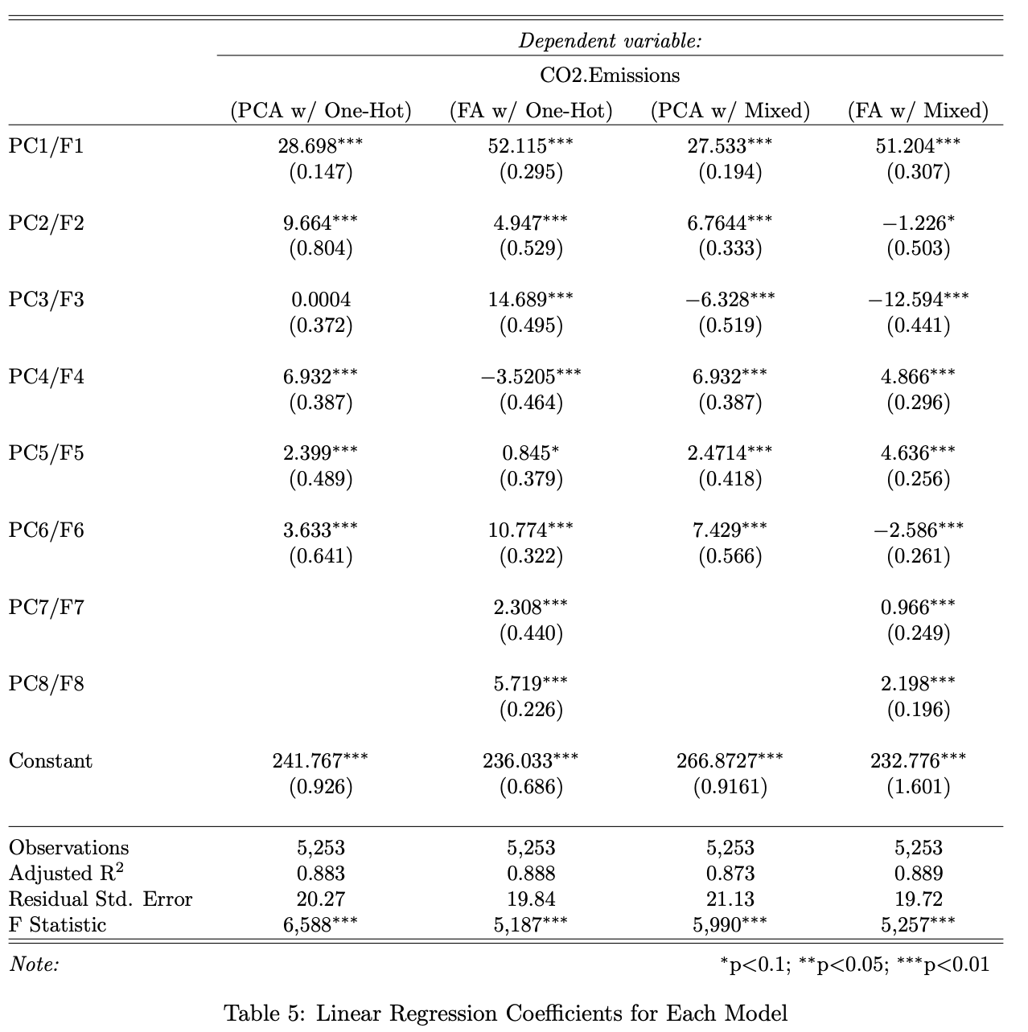
Results & Interpretation
Notice that in each model, the coefficient of the first component, or factor, was a relatively large positive value. This implies that as the abstract measure of engine output increases (described in our interpretations of weights and loadings), we expect the CO2 emissions to increase significantly.

Slide 25
Conclusion & Discussion
Using PCA and Factor Analysis with different approaches to correlation estimation, I was able to successfully calculate and interpret the component weights and factor loadings.
Although the loadings and the associated variances explained changed between each analysis, the interpretation of the first component and factor remained consistent across all four analyses.
Linear models were successfully fit to the associated optimal set of components and estimated factors.
The diagnostic tools and the testing results indicated that each model displayed a great fit and demonstrated excellent ability to predict expected CO2 emissions.
I found that using either PCA or factor analysis for dimensionality reduction led to similar predictive performances.
In this case, using the polychoric and tetrachoric correlations for non-numeric variables did not significantly change the linear model’s performance.

Slide 26
References
[1] UCLA Office of Advanced Research Computing. How can I perform a factor analysis with categorical (or categorical and continuous) variables? URL: https://stats.oarc.ucla.edu/stata/faq/how-can-iperform- a- factor- analysis- with- categorical- or- categorical- and- continuous- variables/. (accessed: 03.09.2023).
[2] Debajyoti Podder. CO2 Emission by Vehicles. URL: https://www.kaggle.com/datasets/debajyotipodder/ co2-emission-by-vehicles. (accessed: 03.09.2023).
[3] William Revelle. mixedCor: Find correlations for mixtures of continuous, polytomous, and dichotomous variables. URL: https : / / www.rdocumentation.org/packages/psych/versions/2.2.9/topics/mixedCor. (accessed: 03.09.2023).

